Slide 1
Lecture 6
SQL - I

Slide 2
SQL language
We express what we want to get, not how to do it technically.
Intuitive syntax. Reminds simple English sentences. Does not allow acronyms.
Support indentation, text wrapping, thus easy-to-read.
Key words and object names are not case sensitive. String comparison is case sensitive (unless in the implementation it is not defined otherwise in the session context - MySQL)
Standardization: 1986, 1992, 1999, 2003, 2005, 2008, 2011
New standard usually includes the previous one.
Standards gradually incorporate other technologies (OO, XML, ...)
The last "pure relational"standard was in 1992.
Implementations have some deviations from the standard.

Slide 3
SQL partitions
Create and modify database objects (Data Definition Language, DDL)
Creating tables, views, indexes, functions, stored procedures and triggers
Integrity constraints definition
Construction of queries (Data Manipulation Language, DML)
Rights and permissions management (Data Control Language, DCL)
Transaction management (Transaction Control Language, TCL)
Data Dictionary
Language of modules – packages, procedures, triggers

Slide 4
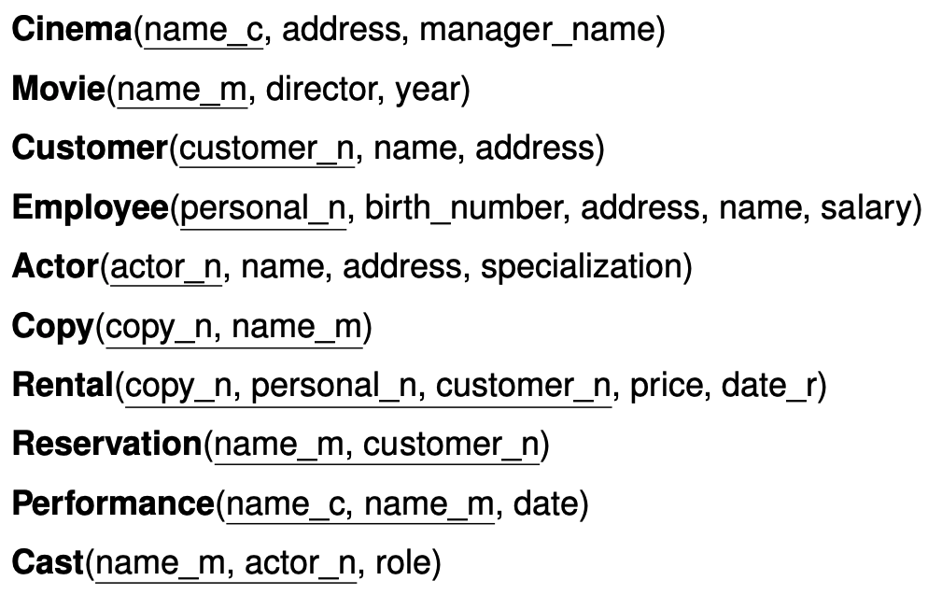
The relational schema used in the examples

Slide 5
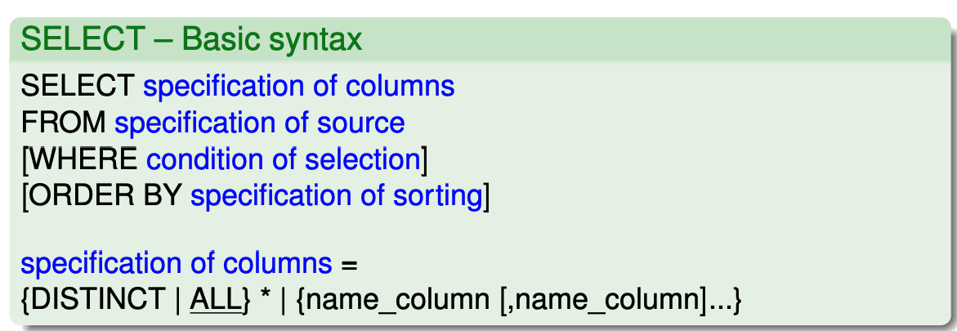
Simple queries

Slide 6
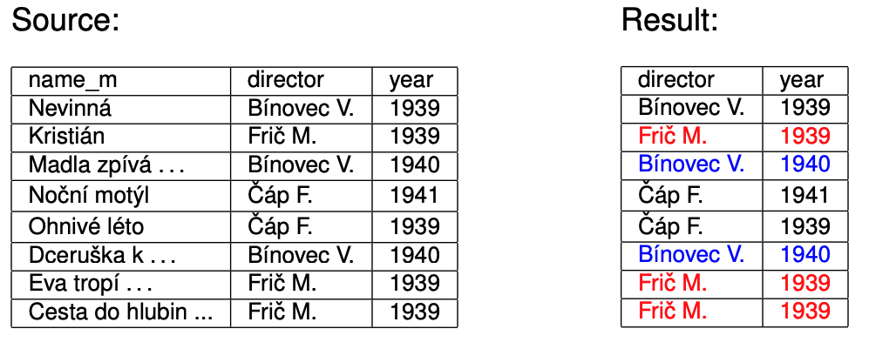
Select names of directors and years, when they directed some movie.
SELECT director, year FROM Movie;

Slide 7
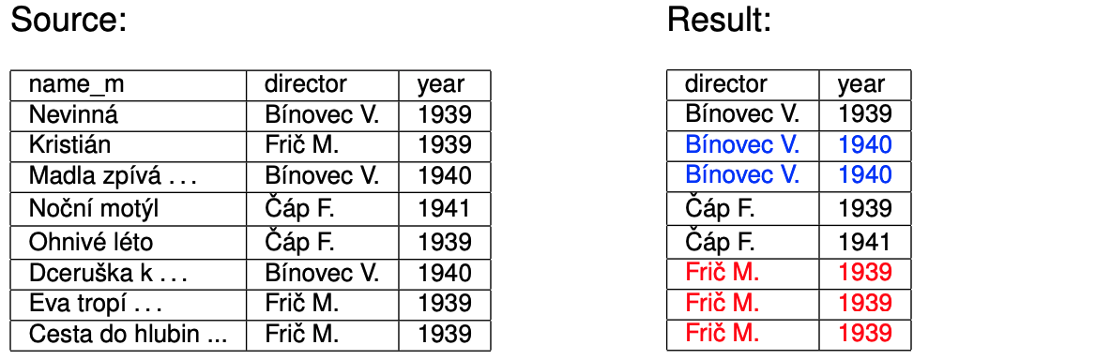
Select names of directors and years, when they directed some movie ordered by director name and year
SELECT director, year FROM Movie ORDER BY director, year;

Slide 8
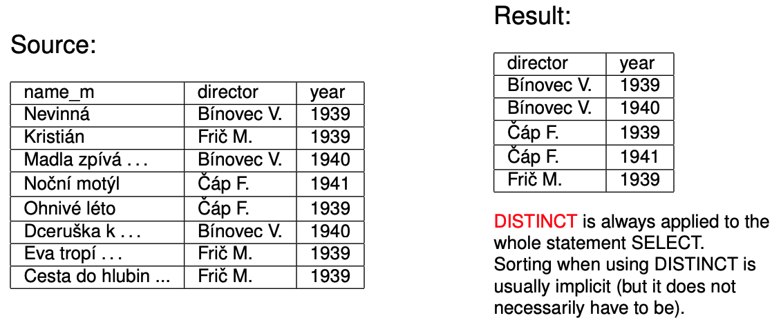
Select unique n-tuples names of directors and years, when they directed some movie.
SELECT DISTINCT director, year FROM Movie;

Slide 9
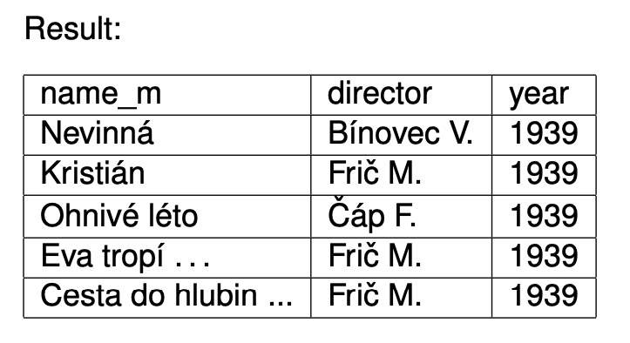
Select all films made before 1940.
SELECT * FROM Movie WHERE year < 1940;

Slide 10
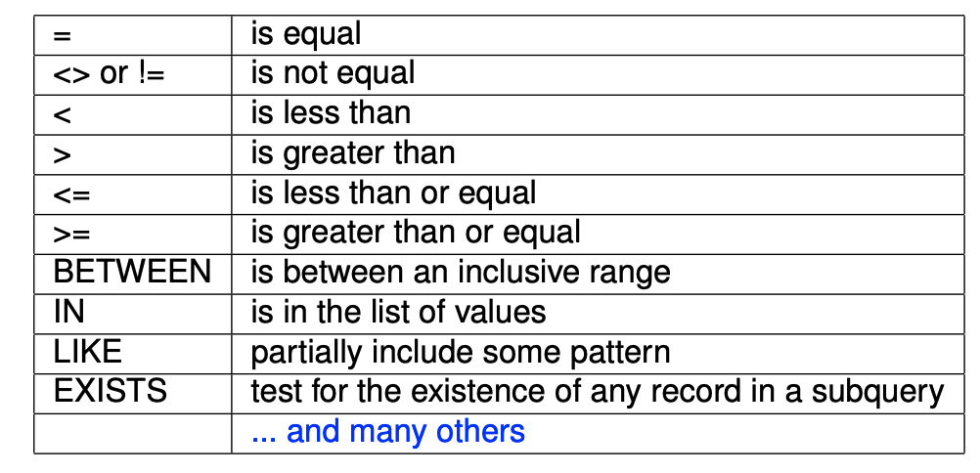
Operators in the WHERE clause
In the WHERE clause it is possible to use logical operations AND, OR and NOT
For the correct order of processing we use parenthesis.
WHERE clause is processed as a boolean expression: result will be TRUE, FALSE or NULL.

Slide 11
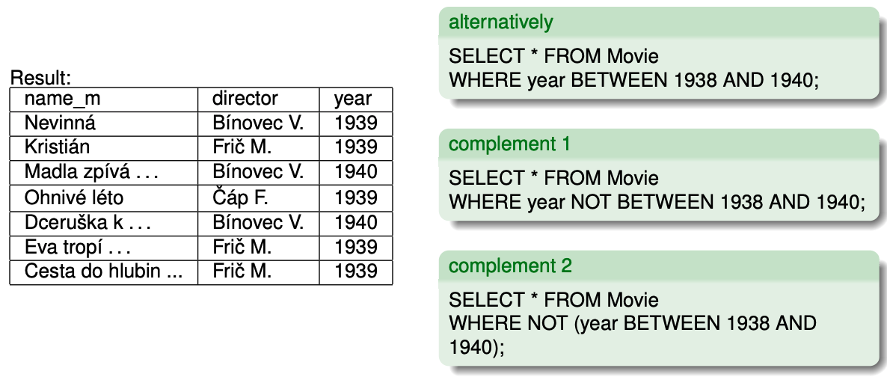
Select movies from MOVIE table that are made in years 1938-1940
SELECT * FROM Movie WHERE year>=1938 AND year<=1940;
Conditions using WHERE clause

Slide 12
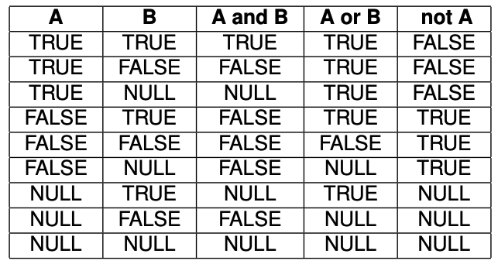
Operations with NULL value
All data types (domains) have “bottom” value NULL.
It means “UNKNOWN”, “UNDEFINED”, “N/A”. It is not zero or empty string!
“Three Values” (TRUE, FALSE, NULL) logic on operations AND, OR and NOT is defined as ->

Slide 13
Operations with NULL value
If at least one operand of comparison (=, <>, <, >, <=, >=) has value NULL, the result of comparison is NULL.
The value of arithmetic expression where at least one element is NULL is also NULL.
The same rule should be valid also for strings. For example ’A’||NULL||’B’ should be NULL.
ATTENTION: for strings this rule could be violated in different implementations:
Oracle: ’A’||NULL||’B’ = AB
PostgreSQL: ’A’||NULL||’B’ = NULL
In practice it is better to avoid NULL values by using: IS NULL, IS NOT NULL and COALESCE.

Slide 14
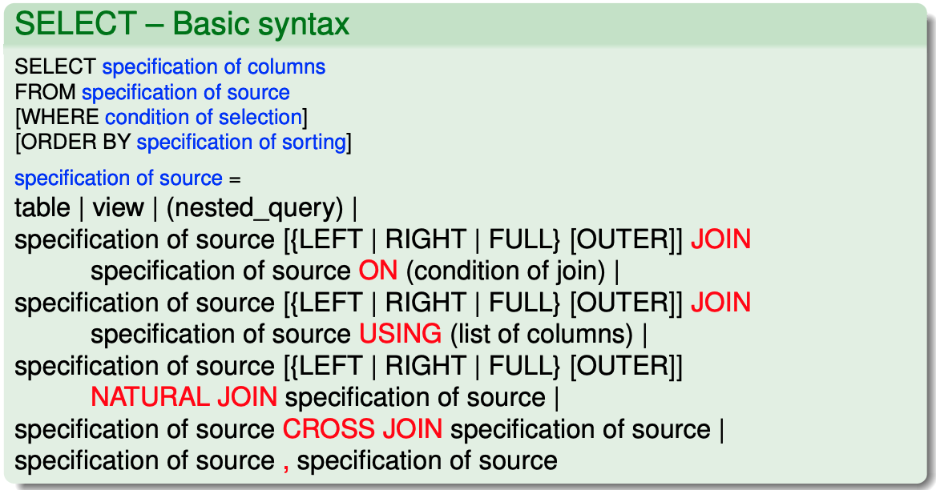
Join of tables

Slide 15
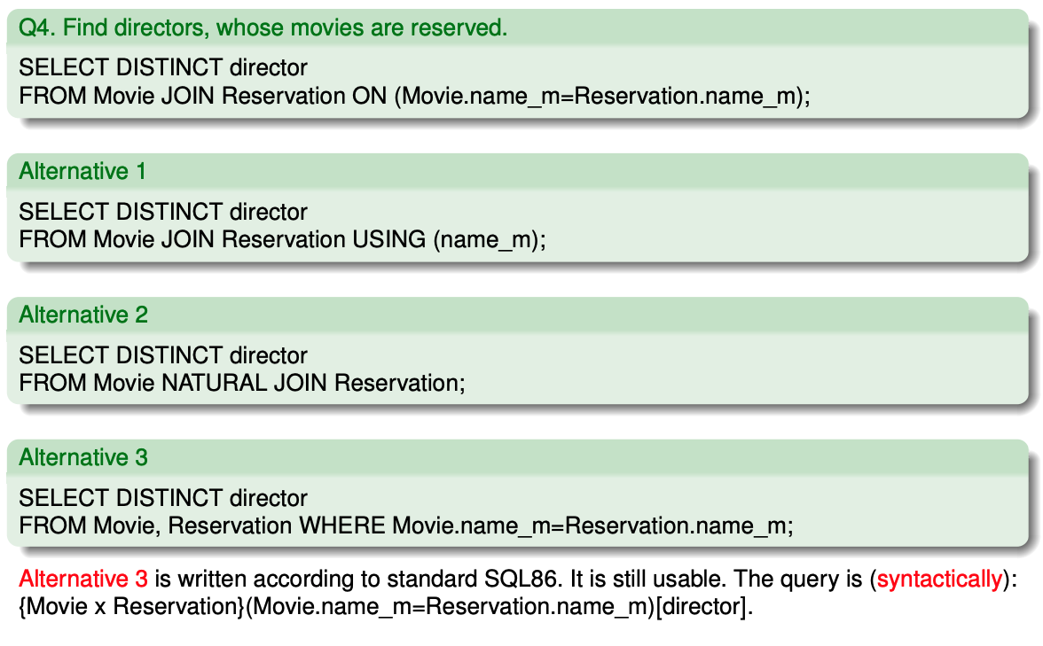
Queries over multiple tables

Slide 16
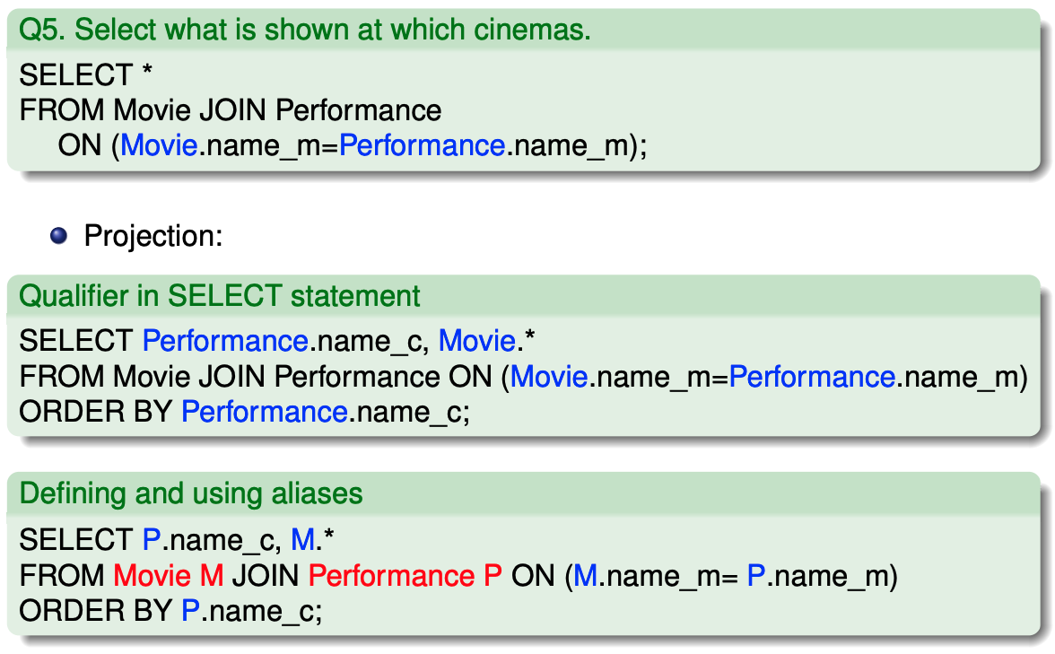
Qualifiers, aliases

Slide 17
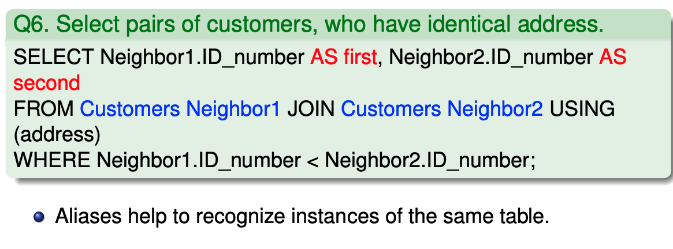
Join table recursively

Slide 18
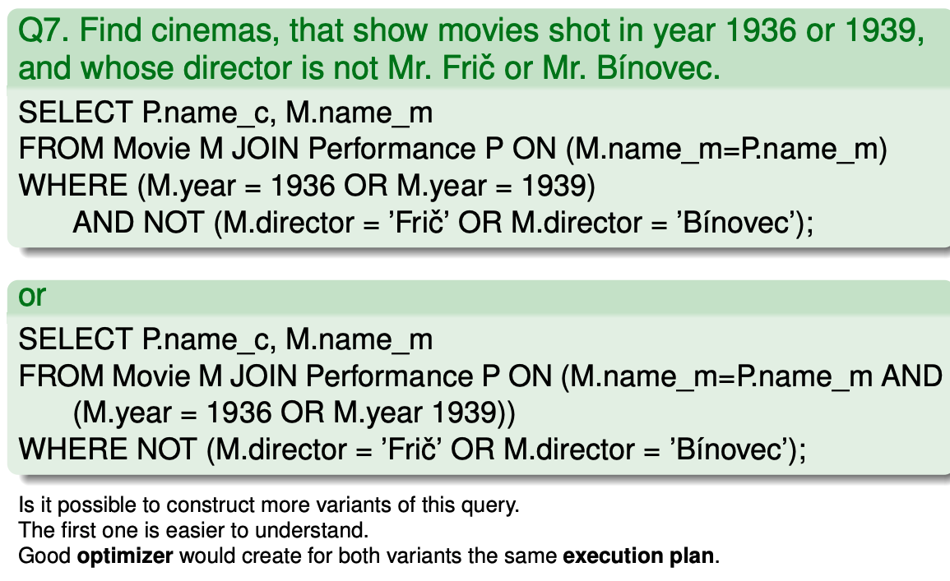
Queries with join and selection

Slide 19
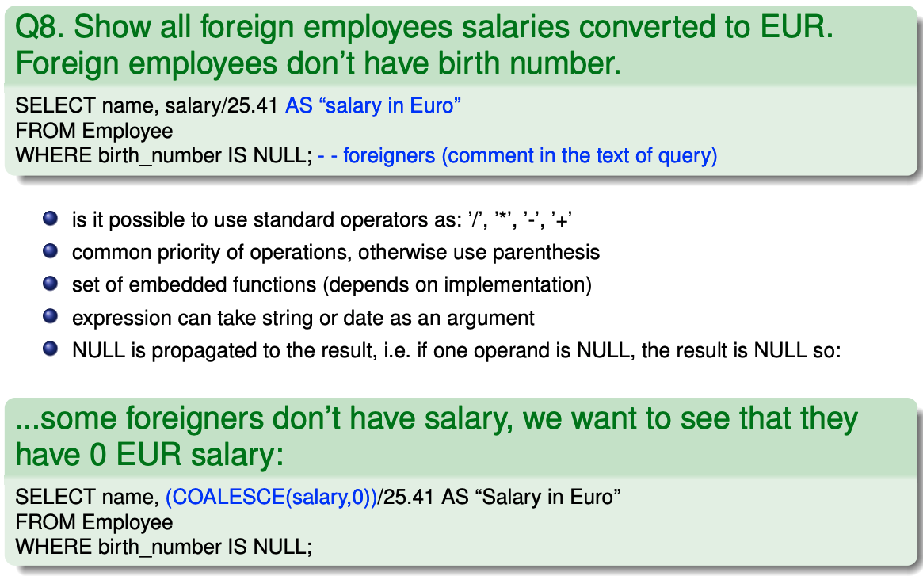
Expressions in SELECT statement

Slide 20
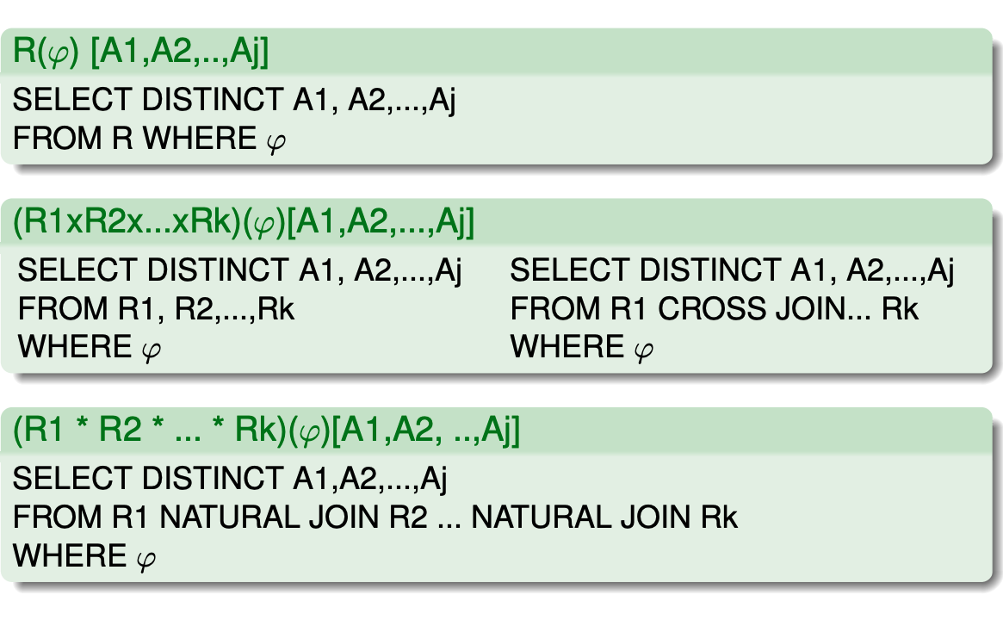
Relational algebra → SELECT 1/2

Slide 21
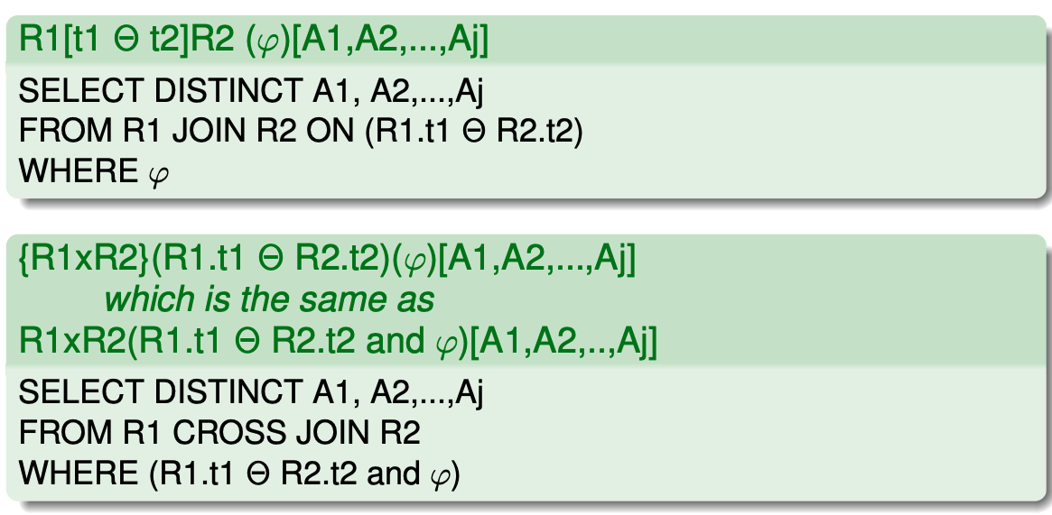
Relational algebra → SELECT 2/2

Slide 22
Important terms
Query, SELECT query structure
Join tables via JOIN clause
NULL value
Conversion of relational algebra to SQL SELECT

